Slide 1


Module 2 Project
Olist Business Proposal
Beyond a million, unlocking new opportunities
Link to Github Project Repository
DS5 Team 5 | Members: Caleb Cheah Peng Huat, Fiona Lim Yan Han, Kevin Chua, Ng Zhenxian, Soh Shi Hui
June 2026
Notes:
Assignment guidelines https://docs.google.com/document/d/1kVCs9awnHM2iAI41pAjkEGpWzKBs0wEEwzjtxHDbE_s/edit?tab=t.0#heading=h.4rd2psd5fk16
Dashboard link: https://fionalimyh.github.io/DS5-Team-5---Module-2-Assignment-Project/

Slide 2
Agenda
1
Business Case
2
Data Pipeline Architecture
3
Star Schema & Dashboard
4
Business Opportunities
5
Risks & Mitigations

Slide 3

Business Case
Executive Summary
Data driven revenue growth
Business Case
The company has transitioned from its initial growth phase into a stable revenue state, consistently generating R$1M per month since Q4 2017.
Key Strategies
High-potential states are identified based on GDP as a proxy for spending power relative to company revenue
Drive revenue growth by expanding into top 5 underserved high-potential states and promoting proven top-performing product categories.
Business Value
5 Target States:
BA, PE, CE, AM & PA
Estimated upside: ~R$700K
Conservative case: ~R$300k
Aggressive case: ~R$1.1M
DS5 Team 5 | Members: Caleb Cheah Peng Huat, Fiona Lim Yan Han, Kevin Chua, Ng Zhenxian, Soh Shi Hui
June 2026
Notes:
Executive Summary: A quick 2-3 minute summary of the problem, your solution, and why it matters.

Slide 4
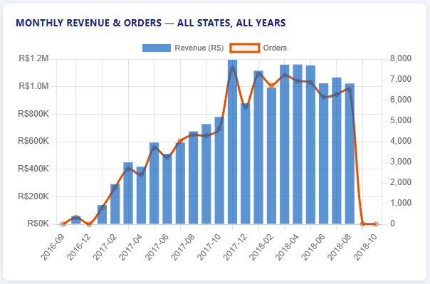
Business Case
Business Case
Data Science: Fueling the Next Leap
Consistent Growth → Strong trajectory from startup to Q4 2017
Stable Revenue → Monthly stream holding steady at ~R$1M since 2017
Future Focus → Team tasked to unlock new opportunities and drive revenue growth
DS5 Team 5 | Members: Caleb Cheah Peng Huat, Fiona Lim Yan Han, Kevin Chua, Ng Zhenxian, Soh Shi Hui
June 2026
Notes:
Growth phase successfully transitioned into stability.
Reliable R$1M/month revenue provides a solid foundation.
Next challenge: leverage data science to drive innovation and expansion.

Slide 5
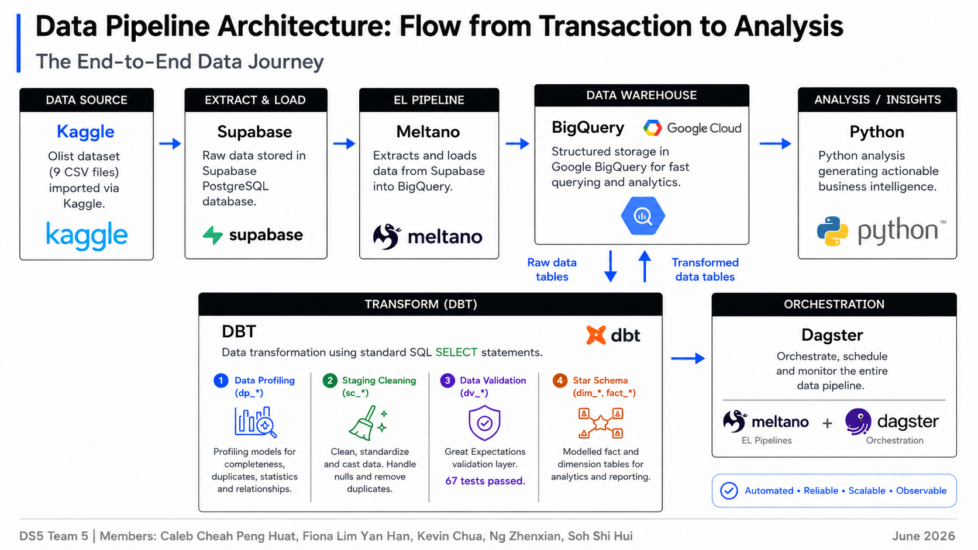
Technical Overview:
Data Pipeline Design
Data Pipeline Architecture
DS5 Team 5 | Members: Caleb Cheah Peng Huat, Fiona Lim Yan Han, Kevin Chua, Ng Zhenxian, Soh Shi Hui
June 2026

Slide 6
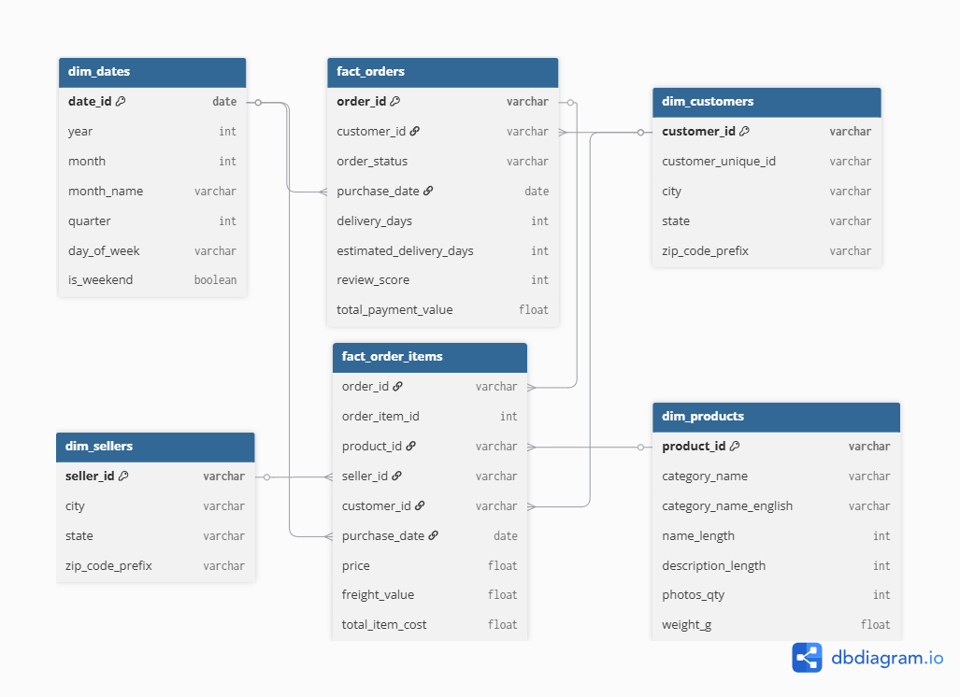
Data Quality & Star Schema
Star Schema Design
Main table types
Fact tables: transaction metrics at order and order-item level.
Dimension tables: customer, product, seller, and date context for analysis.
Link: https://dbdiagram.io/d/version-2-6a3118a15c789b8acb9377d1
DS5 Team 5 | Members: Caleb Cheah Peng Huat, Fiona Lim Yan Han, Kevin Chua, Ng Zhenxian, Soh Shi Hui
June 2026
Notes:
Update schema after Caleb upload the new dataset and schema

Slide 7

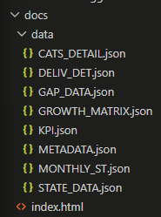
Data Quality & Star Schema
Dashboard Design
Extract & Query → Data from GCP, 7 BigQuery SQL queries → JSON files
Static Site → index.html + JSON, no server/database
Render Charts → Browser loads JSON, computes values → charts (growth, gaps, map, trends)
Auto-Update (upcoming) → GitHub Actions refresh JSON with latest BigQuery data
https://fionalimyh.github.io/DS5-Team-5---Module-2-Assignment-Project/
DS5 Team 5 | Members: Caleb Cheah Peng Huat, Fiona Lim Yan Han, Kevin Chua, Ng Zhenxian, Soh Shi Hui
June 2026
Notes:
Update schema after Caleb upload the new dataset and schema

Slide 8
Business Opportunities
Key Business Metrics
Live values from BigQuery
TOTAL REVENUE
AVG REVIEW SCORE
ON-TIME DELIVERY
R$15.9M
4.09
93.3%
2016–2018
Max = 5
Actual ≤ estimated date
Revenue Intensity
Revenue per R$1M GDP
High revenue intensity means company generating revenue efficiently relative to size of economy
Market Gap
GDP share% − Revenue share%
This number should be close to zero. Revenue share% should ideally be equal to GDP share of the state.
New Growth Metrics
DS5 Team 5 | Members: Caleb Cheah Peng Huat, Fiona Lim Yan Han, Kevin Chua, Ng Zhenxian, Soh Shi Hui
June 2026

Slide 9
Business Opportunities
Revenue Insights
Top product categories and revenues by state
Top Product Categories by Revenue
Top Customer States by Revenue
Health & Beauty
R$1.44M
SP
R$6.00M
Watches & Gifts
R$1.31M
RJ
R$2.14M
Bed, Bath & Table
R$1.24M
MG
R$1.87M
Sports & Leisure
R$1.16M
RS
R$0.89M
Computers & Accessories
R$1.06M
PR
R$0.81M
Furniture & Décor
R$0.90M
SC
R$0.62M
Housewares
R$0.78M
BA
R$0.62M
Cool Stuff
R$0.72M
DF
R$0.36M
DS5 Team 5 | Members: Caleb Cheah Peng Huat, Fiona Lim Yan Han, Kevin Chua, Ng Zhenxian, Soh Shi Hui
June 2026

Slide 10
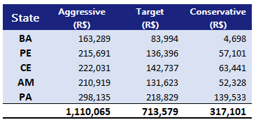
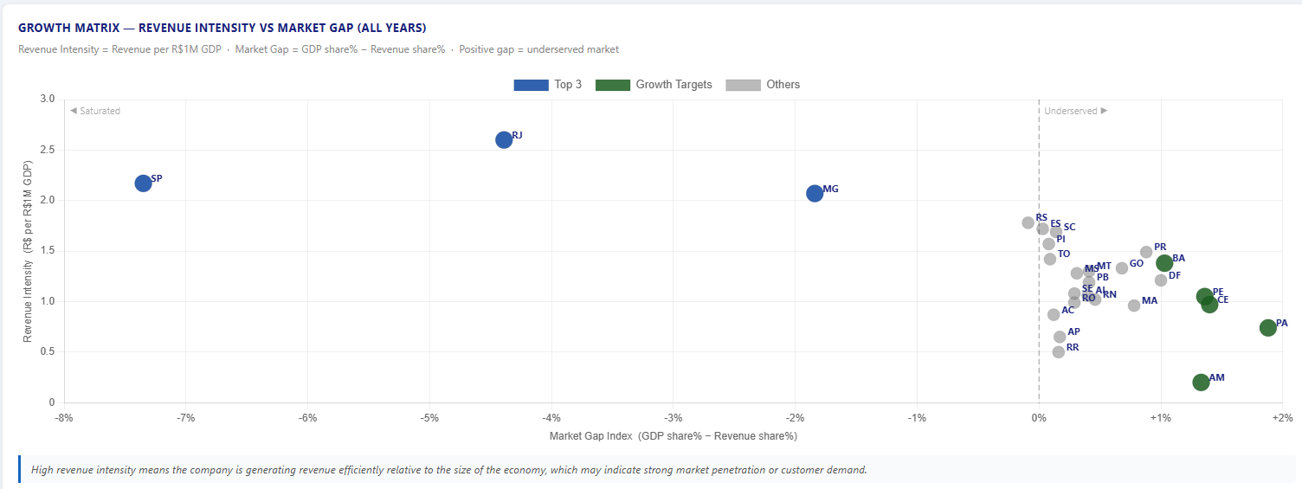
Business Opportunities
Identifying High-Potential New Markets
Compares revenue with GDP to find states where market potential is not yet captured.
Underserved
Top 5 underperforming states relative to earnings → Signals growth opportunity BA, PE, CE, AM & PA
DS5 Team 5 | Members: Caleb Cheah Peng Huat, Fiona Lim Yan Han, Kevin Chua, Ng Zhenxian, Soh Shi Hui
June 2026
Notes:
PA - Pará
PE - Pernambuco
AM - Amazonas
CE - Ceará
BA - Bahia

Slide 11
Business Opportunities
Recommended Business Strategy
1
2
Category-Led Promotion
Promote the top 5 categories in target states.
Health & Beauty
Watches & Gifts
Bed, Bath & Table
Sports & Leisure
Computers & Accessories
Capture Underserved States
Target BA, PE, CE, AM & PA.
Revenue is below spending power, suggesting room to scale.
Estimated upside: ~R$ 700K
Conservative case: ~R$ 300K
Aggressive case: ~R$ 1.1M
DS5 Team 5 | Members: Caleb Cheah Peng Huat, Fiona Lim Yan Han, Kevin Chua, Ng Zhenxian, Soh Shi Hui
June 2026
Notes:
Success matrix: Revenue, GDP, categories, 5 states growth (based on GDP)

Slide 12
Risks & Mitigations
Risks & Success Metrics
Roll out in phases, validate assumptions, and track whether the growth strategy is working.
1
Pipeline & Governance Risk
Risk: Automation failures or loading of incomplete data without timely detection.
Mitigation: Introduce Data Observability and Quality Monitoring Layer to detect
Failures & Retries
Source freshness checks
Dbt tests
Metrics: Pipeline success · Refresh age · Test pass rate · Failed assets · Recovery time
Goal: To keep the dashboard accurate and reliable while automating the process.
2
Service Quality Risk
Risk: Higher order volume may lead to delivery delays and lower review scores.
Mitigation: Before scaling campaigns,
Delivery capacity review
Seller coverage checks
Phased campaign rollout
Metrics: On-time delivery · Review score · Delivery delay rate
Goal: To support revenue growth without reducing delivery performance or customer satisfaction.
DS5 Team 5 | Members: Caleb Cheah Peng Huat, Fiona Lim Yan Han, Kevin Chua, Ng Zhenxian, Soh Shi Hui
June 2026
Notes:
Based on our pipeline and growth strategy, we summarise 2 main risks + mitigation method and success metrics.
Firstly, for Pipeline & Governance Risk,
As we’re running automations on dagster and potentially github actions, we risk having no timely detection for automation failures.
Result in having inaccurate data on our dashboard.
To mitigate this risk, we can add a data observability and quality monitoring layer which helps to detect.
We be monitoring 5 success metrics as shown.
And the goal is to ensure that we have reliable and accurate data, while automating our processes.
Secondly, we have Service Quality Risk,
We risk having delivery delay and lower review score due to high order volume.
So mitigate risk, first, we conduct a delivery capacity review. To check whether the fulfilment and logistics network can handle higher order volumes without causing delays.
Second, we will perform seller coverage checks. To confirm that there are enough active sellers and sufficient available products in each target state, before launching larger campaigns.
// Third, we will use a phased campaign rollout.// So, Instead of scaling all campaigns at once, we will begin with a smaller pilot.
We will monitor delivery performance and customer feedback before expanding further.
These actions help ensure that revenue growth does not come at the expense of delivery quality or customer satisfaction.

Slide 13
Thank you
DS5 Team 5 | Members: Caleb Cheah Peng Huat, Fiona Lim Yan Han, Kevin Chua, Ng Zhenxian, Soh Shi Hui
June 2026
Notes:
Assignment guidelines https://docs.google.com/document/d/1kVCs9awnHM2iAI41pAjkEGpWzKBs0wEEwzjtxHDbE_s/edit?tab=t.0#heading=h.4rd2psd5fk16
Dashboard link: https://fionalimyh.github.io/DS5-Team-5---Module-2-Assignment-Project/

